Slide 1

CS302 Design and Analysis of Algorithms
Muhammad sohail afzal

Slide 2
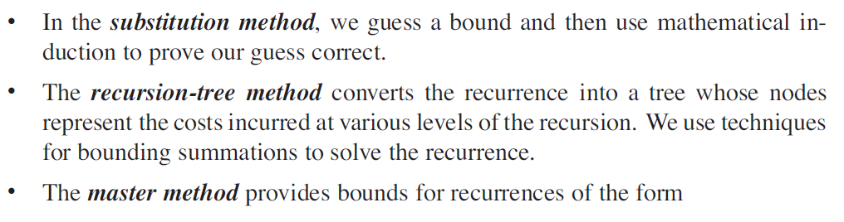

Solving Recurrences
There are three methods for solving recurrences—that is, for obtaining asymptotic bounds on the solution :

Slide 3
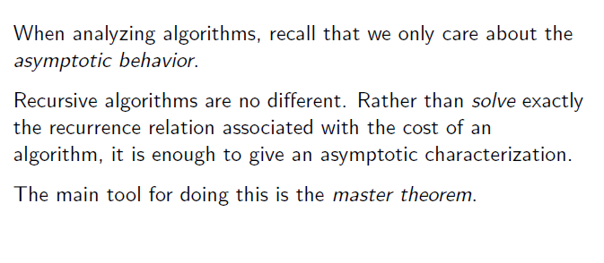
Master Method : Solving Recurrences

Slide 4
Master Method : Solving Recurrences
The above T(n) expression characterizes divide and conquer algorithm that creates “a” sub-problems, each of which is “1/b” the size of the original problem.
To use the master method, you will need to memorize three cases, but once you do that, you will easily be able to determine asymptotic bounds for many simple recurrences.

Slide 5
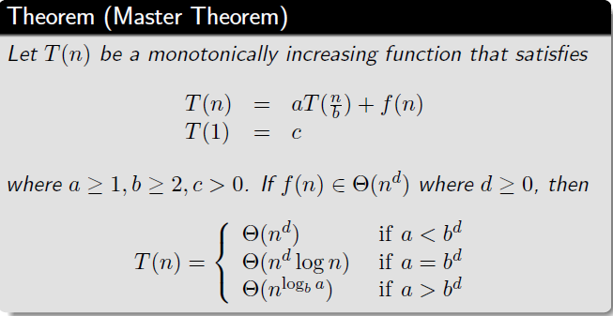
Master Method : Solving Recurrences
Masters Theorem

Slide 6
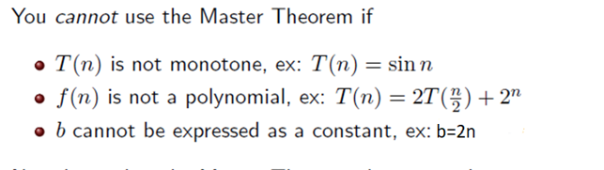
Master Method : Solving Recurrences
Limitations:

Slide 7
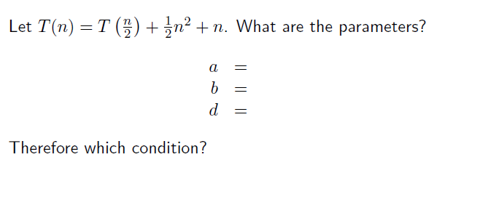
Master Method : Solving Recurrences
Example 1:

Slide 8
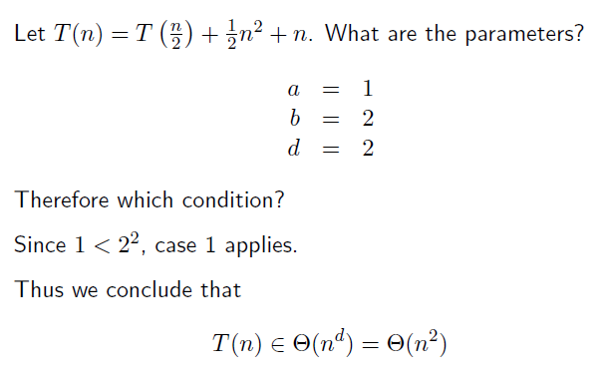
Master Method : Solving Recurrences
Example 1: Solution

Slide 9
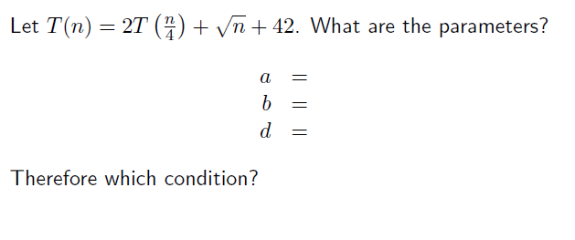
Master Method : Solving Recurrences
Example 2:

Slide 10
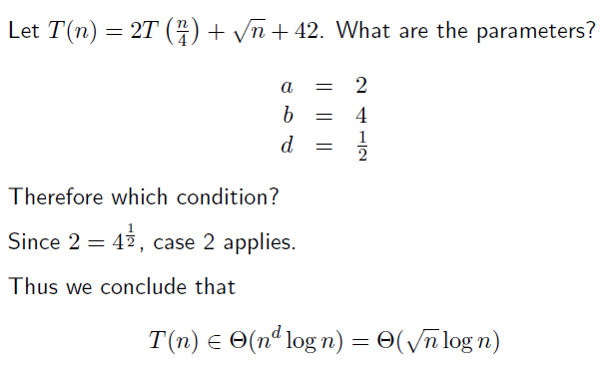
Master Method : Solving Recurrences
Example 2: Solution

Slide 11
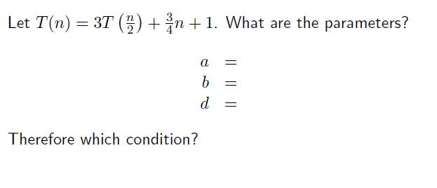
Master Method : Solving Recurrences
Example 3:

Slide 12
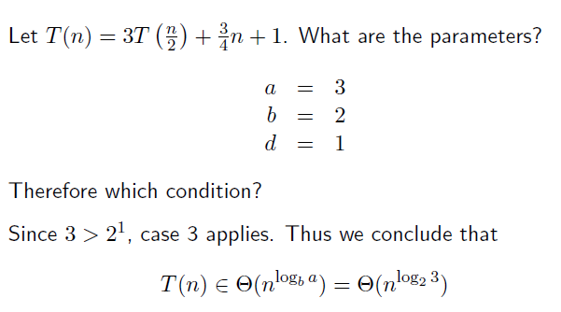
Master Method : Solving Recurrences
Example 3: Solution

Slide 13
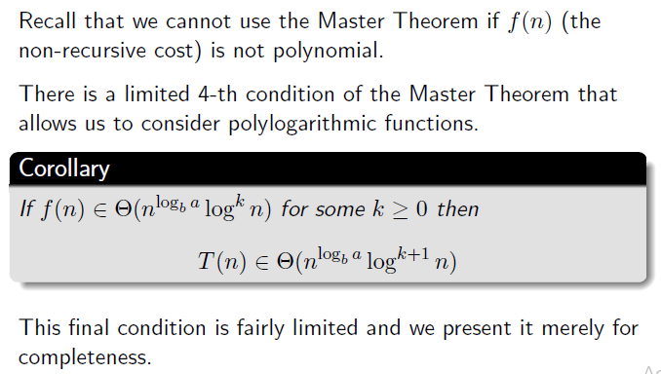
Master Method : Solving Recurrences
Fourth Condition:

Slide 14
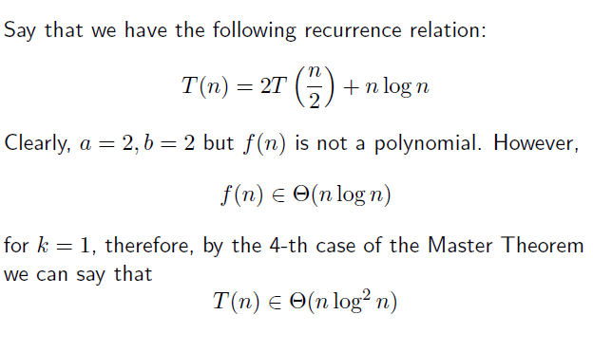
Master Method : Solving Recurrences

